Slide 1
What Is Food Science?
Chapter 1

Slide 2
Notes:
While students watch, have the listen for
Who is responsible for protecting our food supply? FDA and USDA
What are some careers associated with Food Science?
Why are some foods fortified?

Slide 3
Food Science is the study of
Producing
Processing
Preparing
Preserving
Packaging
Evaluating
Using food

Slide 4
producing
Food Chain
Biotechnology
Treat soil
Change gene structures
Scientists specialize in one food group or ingredient

Slide 5
Top Five Accidental Food Inventions

Slide 6
Processing
Create final marketable product
Quality Control
Engineers
Microbiologists
Flavor experts
Sensory evaluation experts
Packaging specialists
Marketing analysts
Products needs to meet government, industry and company standards
Storage – sanitary, correct temperatures & humidity
Nutrient label

Slide 7
Food preparation

Slide 8
Evaluation
Food scientists plus other experts work to refine a products
taste
texture
appearance other qualities

Slide 9
Using food
Various uses for food
Corn
Soy

Slide 10
Why Study food science?
Chapter 2

Slide 11
Why study food science?
Personal Benefits
Social Impacts
Environmental Impacts

Slide 12
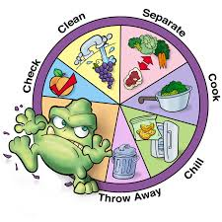
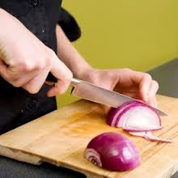
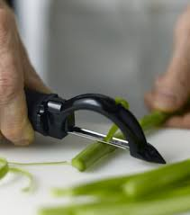
Personal Benefits
Protecting your health
Better nutrition = healthier you
Poor nutrition = Sickness and disease
Understanding Food Safety
Gaining Practical Skills

Slide 13
Social Impacts
Food for the World’s People
biodiversity
Public Health & Safety
Effects on Families

Slide 15
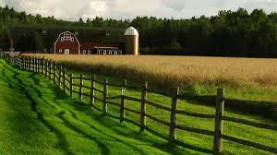
Environmental Impacts
Sustainable Farming
Producing food by natural methods
Integrated pest management (IPM)
Controls pests with nonchemical deterrents

